Slide 1




Bio-Inspired Optimization of the Multiple Traveling Salesman Problem
Kelly Lindsey
National Board Certified Teacher
Boone County High School
Florence, KY
High School Math
Beth Francis
Felicity Franklin Schools
Felicity, OH
Gifted STEM program
Faculty Mentors: Dr. Jeffrey Kastner, Dr. Manish Kumar
Graduate Research Assistant: Mr. Siddharth Sridhar
RET is funded by the National Science Foundation, grant # EEC-1710826

Slide 2
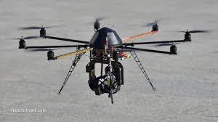
Table of Contents
Introduction
Abstract
Background Literature Review
Goals and Objectives
Research Tasks to be Undertaken
Timeline
Research Training Received
Progress Made
Unit Topic, Essential Question, Challenge

Slide 3
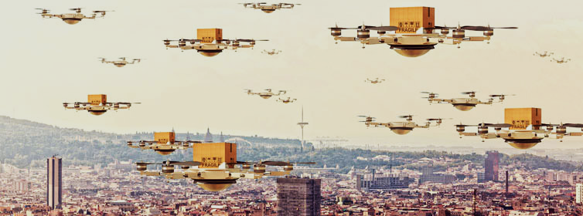
Introduction
APPLICATIONS
Artificial Intelligence
Unmanned Drones
Aerial Surveys
Delivery
FOCUS
Efficient Algorithm
Shorter Paths
Easy to Use
Cover More Territory
Leadingedgeforum.com/asset/6738
Notes:
Drones are being used for aerial surveys and are in development for delivery but have a limited battery life. This research is trying to create an algorithm that will produce the most efficient travel path for the power available.

Slide 4

Abstract
Use Traveling Salesman Problem to optimize travel distance for drones
Test algorithms using MATLAB® to develop a good way to find optimized travel distances
Ultimately - add to body of knowledge of Artificial Intelligence
frankdiana.net

Slide 5
How Many Paths?
(n-1)!
2
City A
City A
City D
City C
City C
City B
City B
(4-1)! / 2 = (3*2*1) / 2 = 3
3 possible circuits
(3-1)! / 2 = 2 / 2 = 1
1 possible circuit
Notes:
Explain Traveling Salesman Problem - 5 cities = 12 circuits, 6 cities = 60, 10 cities = 181,440

Slide 6
Background Literature Review
Lin & Kernighan
1973
Sathyan, Boone, & Cohen
2015
“An Effective Heuristic Algorithm for the Traveling-Salesman Problem”.
“Comparison of Approximate Approaches to Solving the TSP and Its Application to UAV Swarming”
Primary source for early TSP
Recent GRA for Project 3.
Knowledgeable about the applications of the research.
Notes:
What did authors do

Slide 7
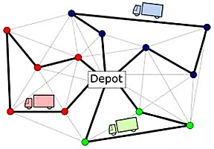
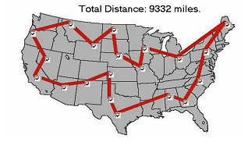
Goals
Understanding of Traveling Salesman Problem
Create a GA by introducing parameters
Develop a GA that uses clustering for the MTSP
www.solver.com/solver-platform-sdk-source-code-examples www.rcasts.com/2010/11/any-r-packages-to-solve-vehicle-routing.html
Notes:
Optimization is finding the best route or the shortest distance.
Find citation for pictures

Slide 8
Objectives
Use clustering with a depot to test GA for MTSP
Learn MATLAB®®coding
Test NN, 2-Opt, GA algorithms
Test modified GA against 2-Opt & GA for more optimal path

Slide 9
Research Tasks to be Undertaken
Background
Literature Review
MATLAB®®
Understanding Code for the TSP algorithms: NN, 2-opt, GA
Analysis
Compare Results
Experiment
Test different values to compare the algorithms
TSP algorithms: NN, 2-opt, GA
Make recommendations
Use MATLAB® to run tests
Apply results to MTSP

Slide 10
Timeline
Week 2 - MATLAB® training
Basics of programming
Intro to TSP, NN, 2-Opt
Week 3 - Intro to Genetic Algorithm
Begin to test parameters
Week 4 - GA Research
Analyze initial GA testing
Choose optimal parameters & test
Week 5 - Compare data from GA & 2-Opt, Intro to Clustering - MTSP,
Compile data into charts & graphs
Week 6 - Finalize data, complete report, poster, PPT, video
Notes:
5 - MTSP

Slide 11
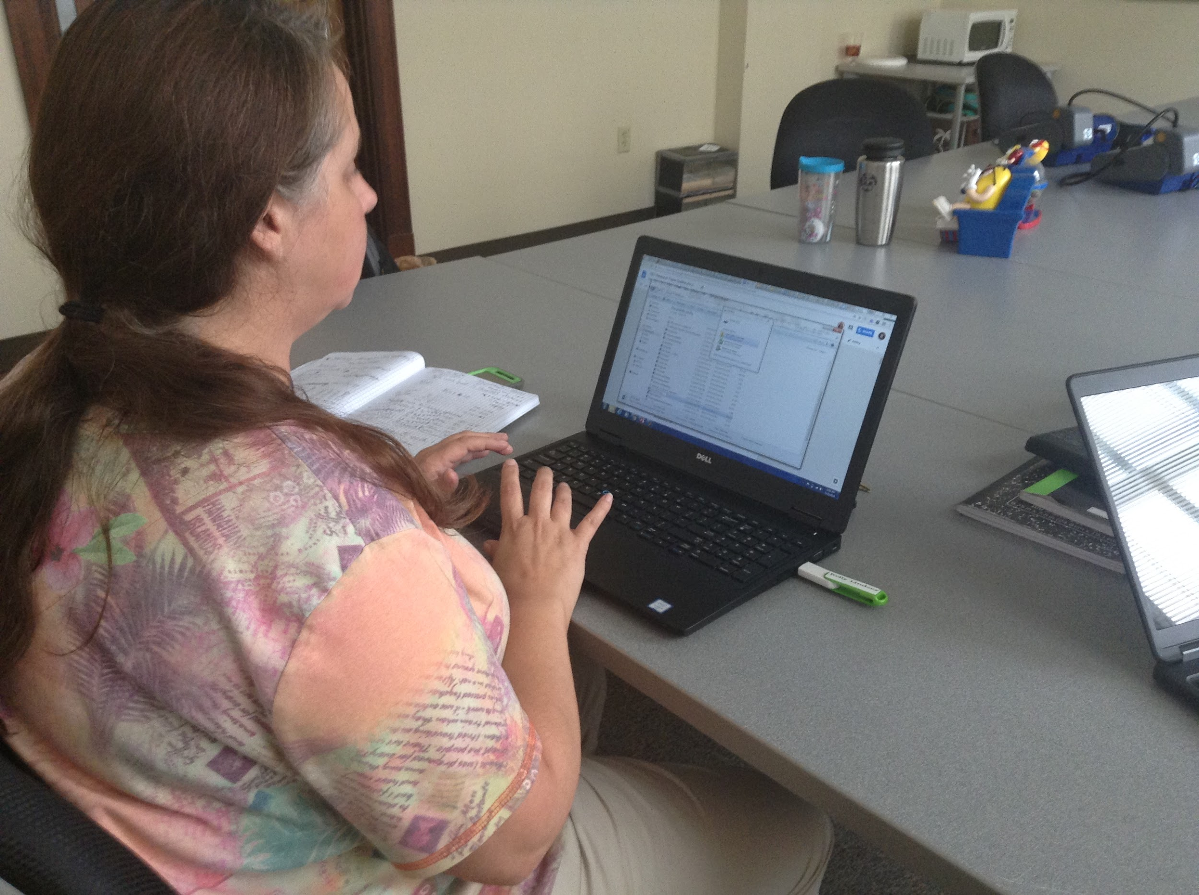
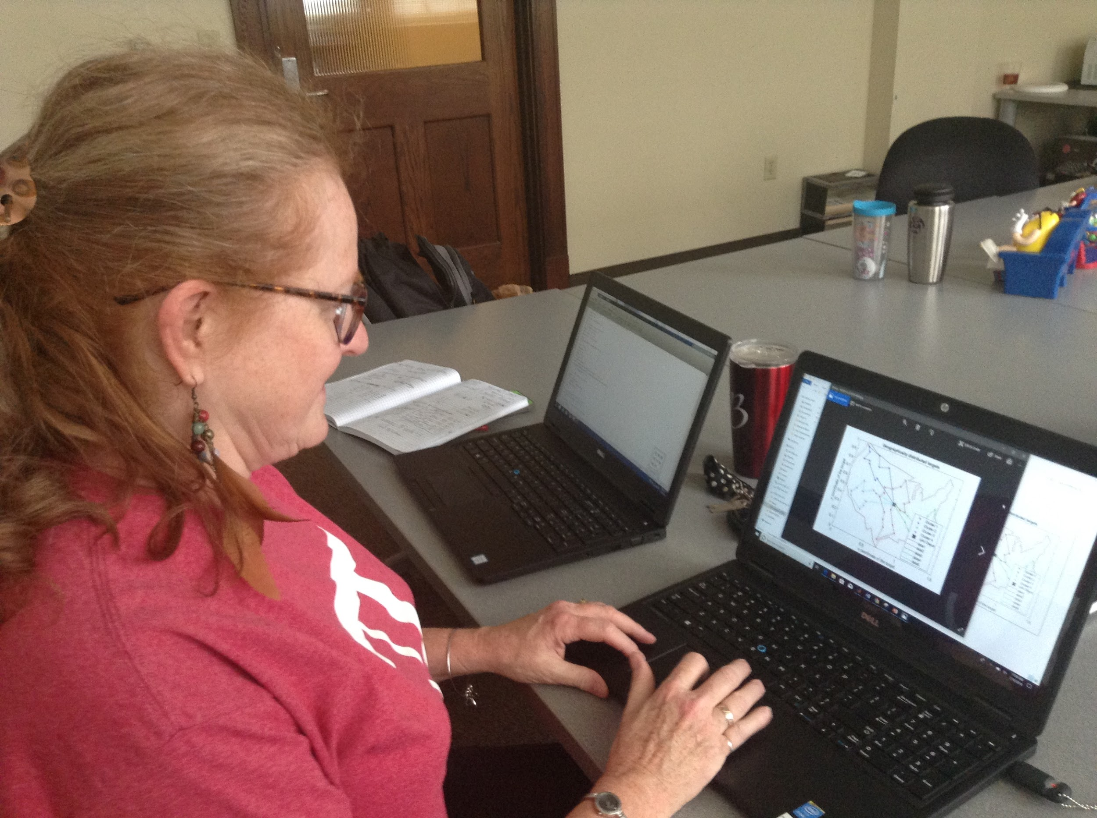
Research Training Received
Tutorials on use of MATLAB®
Reading and understanding MATLAB® programs used to optimize TSP
  Nearest Neighbor
  2-Opt
  Generic GA
How to change parameters and read results on new GA
Clustering and MTSP. How to run parameters and compare data

Slide 12
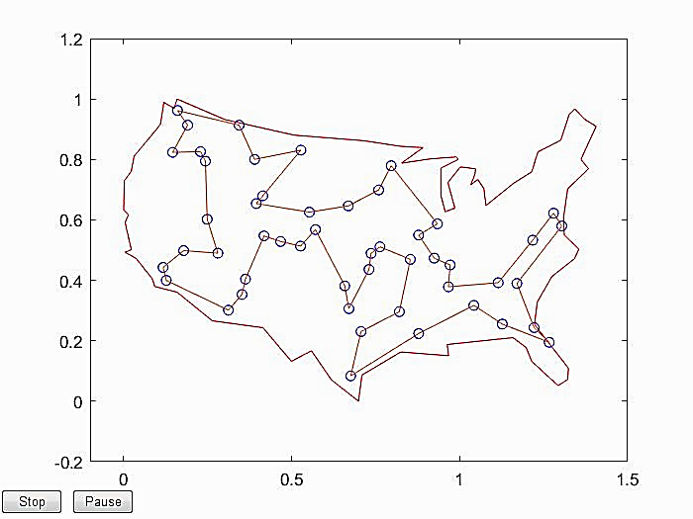
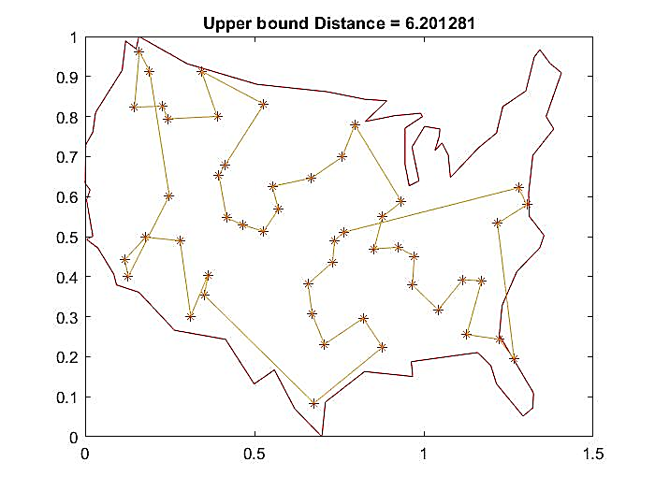
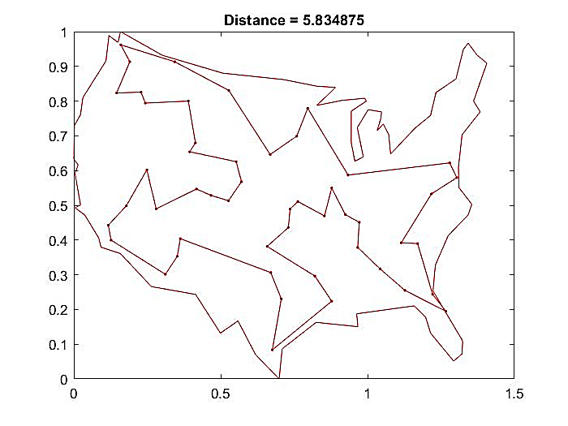
Progress Made
Nearest Neighbor 2-Opt Genetic Algorithm
D=6.2012 D=5.8348 D=5.8373
Notes:
Nearest Neighbor is finding the closest neighbor or city-goes the shortest distance between 2 points.
2 opt-similar to the Nearest Neighbor but makes swaps to eliminate crossover which is where two paths cross each other.
GA is a method of optimization that based on natural selection. It repeatedly modifies solutions to ultimately find the shortest distance. But because it is based on natural selection the population changes for each run.
If we rerun the same parameters, the distance will be different. It’s the average and standard deviation are statistically important to the final solution.
GA-Control parameters: # cities
Start to use colors

Slide 13
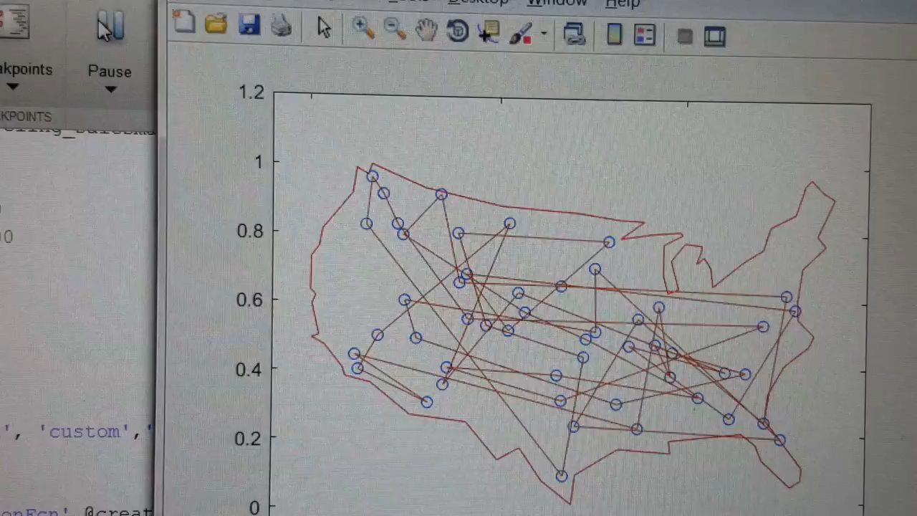

Slide 14
my_GA
Run a range of values for number of generations, population size, and crossover fraction for 1 iteration.
Run chosen sets of parameters for 10 iterations each.
Choose 5 sets of parameters with the shortest distances.
Set of parameters with shortest average distance moves on to comparison test.

Slide 15
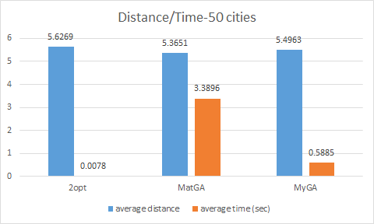
Comparison of 2-Opt, MATLAB® GA, My_GA using 50 randomized cities
Beth’s Data
Randomize 50 cities
Run random list for all 3 algorithms
100 iterations
Shortest distances: 2-Opt 6%
GA 78 %
my_GA 16 %
Comparing GA to my_GA 83% to 17%
Notes:
Add a legend with units to graph

Slide 16
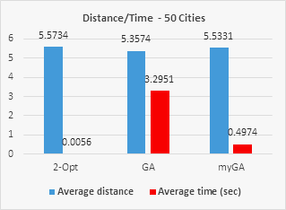
Comparison of 2-Opt, MATLAB® GA, My_GA using 50 randomized cities
Kelly’s Data
Randomize 50 cities
Run random list for all 3 algorithms
100 iterations
Shortest distances: 2-Opt 10%
GA 80%
my_GA 10%
Comparing GA to my_GA 57% to 43%
Notes:
Add a legend with units to graph

Slide 17
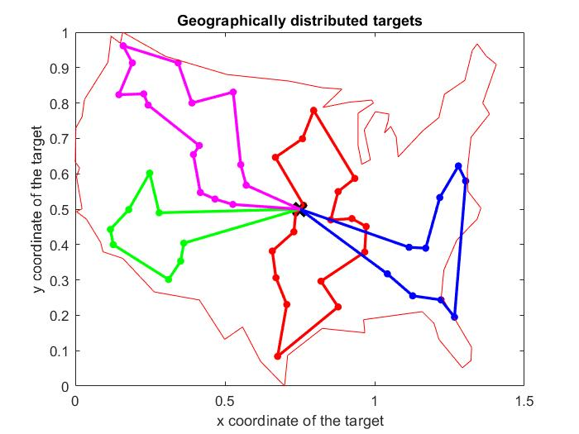
The Multiple Traveling Salesman Problem
Introduce depot
Several small paths

Slide 18
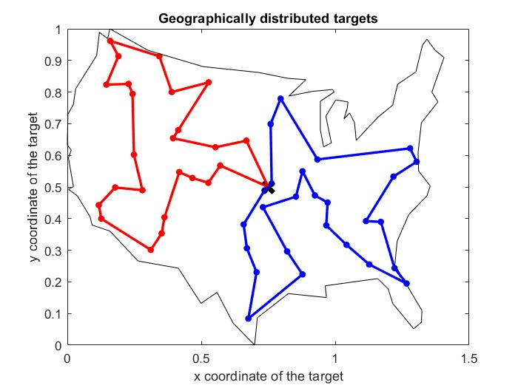
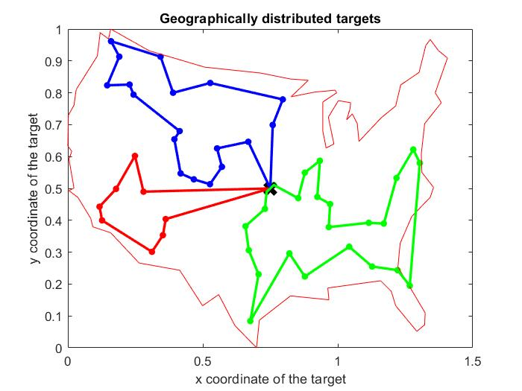
Results of MTSP Testing - Beth

Slide 19
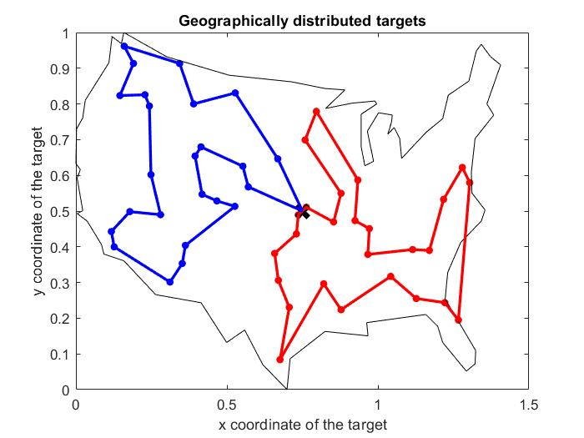
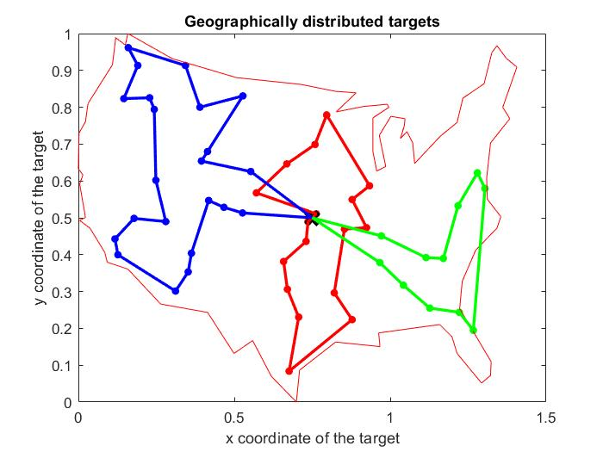
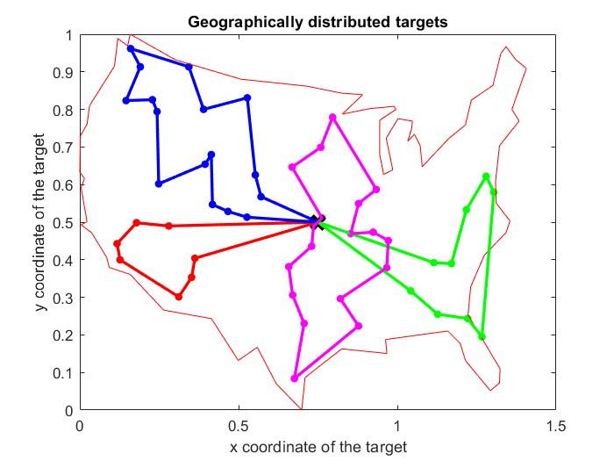
Results of MTSP Testing - Kelly

Slide 20

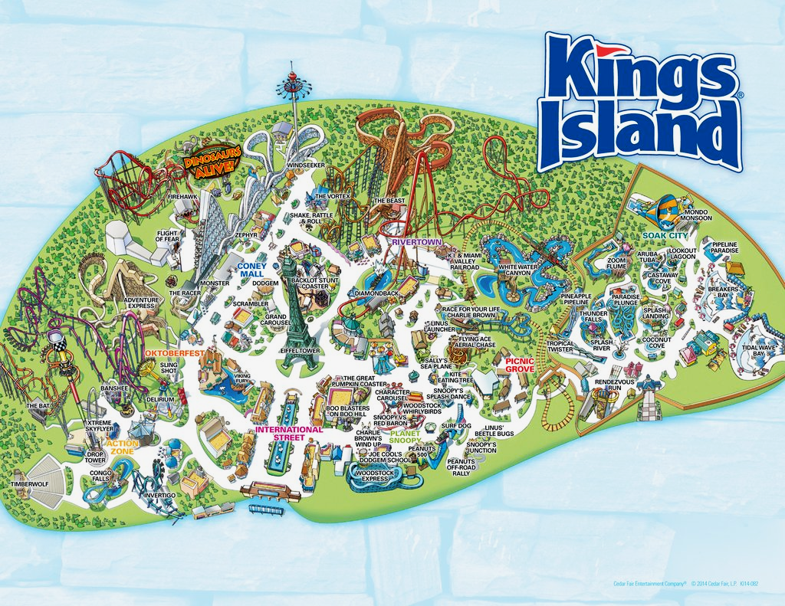
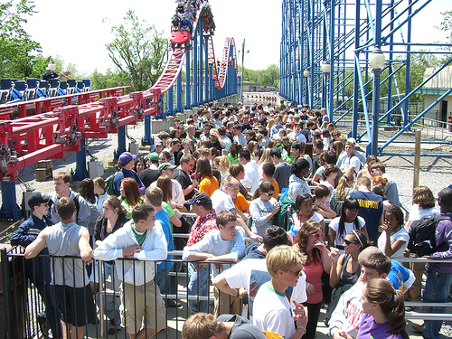
Unit 1: A Day at Kings Island
Beth Francis
https://www.finch.com/se/blog/10093-ppc-optimization-is-all-finch-does
Essential Question: How can I maximize my time on ride and minimize my wait time in line during a day at Kings Island?
Challenge: Students create an optimization plan for a day at Kings Island that works for a specific client.
https://www.mobilemaplets.com/showplace/598
https://www.lifeofdad.com/theme-parks-with-a-kid-i-guess-i-understand-the-excitement-now-kind-of/
Notes:
Students create an optimization plan for a day at Kings Island that works for a specific client. Clients will be different levels of thrill seekers. As a class, we will create a flow chart for an Roller Coaster Optimization App.

Slide 21
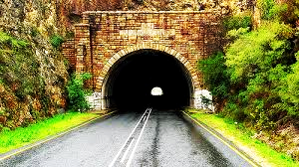
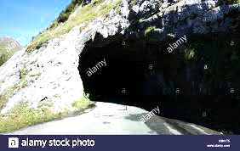
Unit 1 - Building a Better Tunnel
What makes an efficient tunnel?
Can we design/make one?
Skyscrapercity.com
Essential Question: How can we model an efficient tunnel algebraically and physically?
Challenge: Students use algebraic function equations to model a tunnel, revise the tunnel equations, and then build and test a physical model of the tunnel.
Notes:
Cite the pictures

Slide 22

RET is funded by the National Science Foundation, grant # EEC-1710826
Project Faculty Mentors, Dr. Jeff Kastner and Dr. Manish Kumar
Graduate Research Assistant, Mr. Siddharth Sridhar
RET Project Director and Principal Investigator, Dr. Anant Kukreti
RET Co-Project Director and Co-Principal Investigator, Dr. Margaret Kupferle
RET Resource Persons and Grant Coordinators, Debbie Liberi and Kristin Barnes
RET Engineering Resource Teacher, Pamela Truesdell

